Slide 1
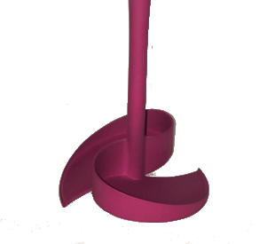

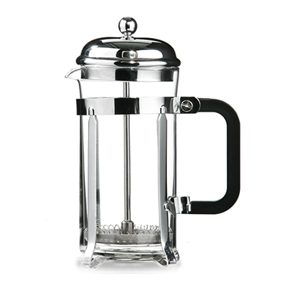
Home
Scoof® images
The scoop with a twist
Home
Cafetiere coffee
Mess free cleaning
Recycle & compost
Block free sinks
FAQs
Shop
Scoof® cleans cafetieres easily
Cafetiere images

Slide 2
Home/ scroll down
Scoof® cleans cafetieres easily
Quality coffee
Have it your way
Low cost
Simplicity
Is this page needed?

Slide 3
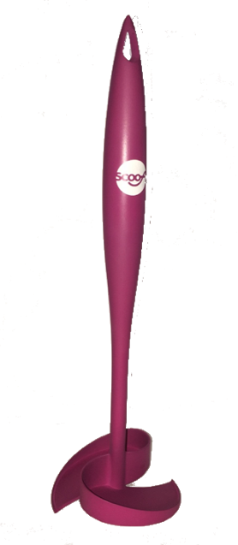
Home / scroll down
Scoof® cleans cafetieres easily
Quality coffee
Cafetieres make high quality coffee from beans or freshly ground
In a survey the quality of cafetiere coffee was preferred or rated as highly as all other methods apart from expensive bean to cup machines.
Coffee picture

Slide 4
Home / scroll down
Scoof® cleans cafetieres easily
Simplicity
Making coffee in a cafetiere is simple and convenient
Just add your desired amount of coffee, pour over water (just before it boils is best). Give it a stir, wait 4 minutes and then depress the plunger.
A simple an pleasurable ritual resulting in an high quality coffee
Cafetiere picture

Slide 5
Home / scroll down
Scoof® cleans cafetieres easily
Have it your way
Cafetiere coffee puts you in charge – your coffee to your taste
More and more of us are choosing our own beans and our own blend, to get the most out of our coffee experience
Beans/ grind/cups picture

Slide 6

Home / scroll down
Scoof® cleans cafetieres easily
Low cost
Cafetiere coffee is less than half the price of coffee pods
A typical pack of fresh coffee will be enough for 25 cups – just 12 pence a cup
Price image

Slide 7
Cafetiere coffee
The scoop with a twist
Home
Cafetiere coffee
Mess free cleaning
Recycle & compost
Block free sinks
FAQs
Shop
Scoof® cleans cafetieres easily

Slide 8
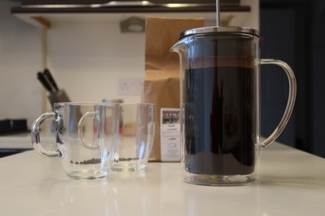
Cafetiere coffee/ scroll down
Scoof® cleans cafetieres easily
Simple steps to perfect coffee
E.g. 4 x 10g scoops of coarse ground coffee per 1 litre (8 cup) cafetiere. Makes 3 large cups or 8 espresso cups
Warm cafetiere with hot water
Add coarse ground coffee to your taste
Pour over hot water
Stir Let it stand for about 4 minutes
Plunge down slowly
Pour and enjoy
Leave to cool just below boiling point is best to avoid coffee being scalded
Perfect cafetiere coffee image
Stirring with a wooden spoon lets the flavour infuse easily - add will not break the pot!

Slide 9
Cafetiere coffee/ scroll down
Cafetieres have different names
French Press
Koffiekan
Coffee Press
Kaffeebereiter
Coffee Maker
Caffettiera
Coffee Plunger
Кофейник
Cafetiere a Piston

Slide 10
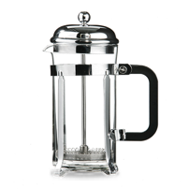
Cafetiere coffee/ scroll down
Many different styles
Borosilicate glass
Cafetiere images
Steel
Double walled
Ceramic

Slide 11
Cafetiere coffee/ scroll down
A range of different sizes
Small cafetieres
6cm diameter plunger
(for 3 cup sizes)
Standard cafetieres
8.5cm diameter plunger
(for 8, 6, and 4 cup sizes)
Large cafetieres
10cm diameter plunger
(for 12 cup sizes)
Sizing diagram

Slide 12
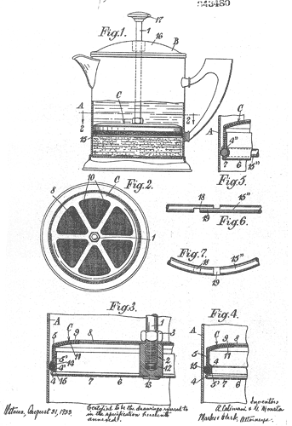
Cafetiere coffee/ scroll down
Did you know?
The first cafetière à Piston appeared in France in the 1850’s
In 1929 Italian Attilio Calimani registered the design
In the 1960’s Household Articles Ltd introduced it to the UK
Now coffee lovers enjoy cafetiere coffee all around the world
Calimani's patent drawings, 1929

Slide 13
Cafetiere coffee
The scoop with a twist
Home
Cafetiere coffee
Mess free cleaning
Recycle & compost
Block free sinks
FAQs
Shop
Scoof® cleans cafetieres easily

Slide 14
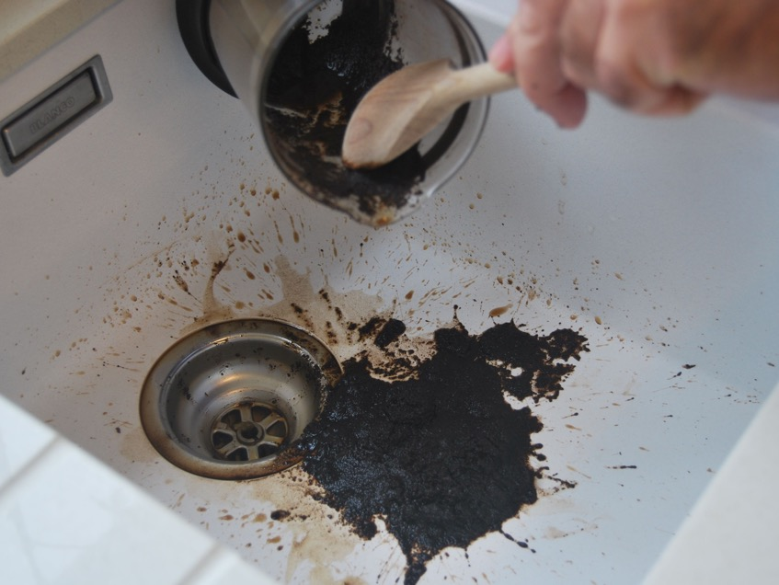
Home / scroll down
Cafetieres are a mess to clean up
Mess image

Slide 15
Home / scroll down
Cleans cafetieres easily
Easy
No mess
No sink blockages

Slide 16
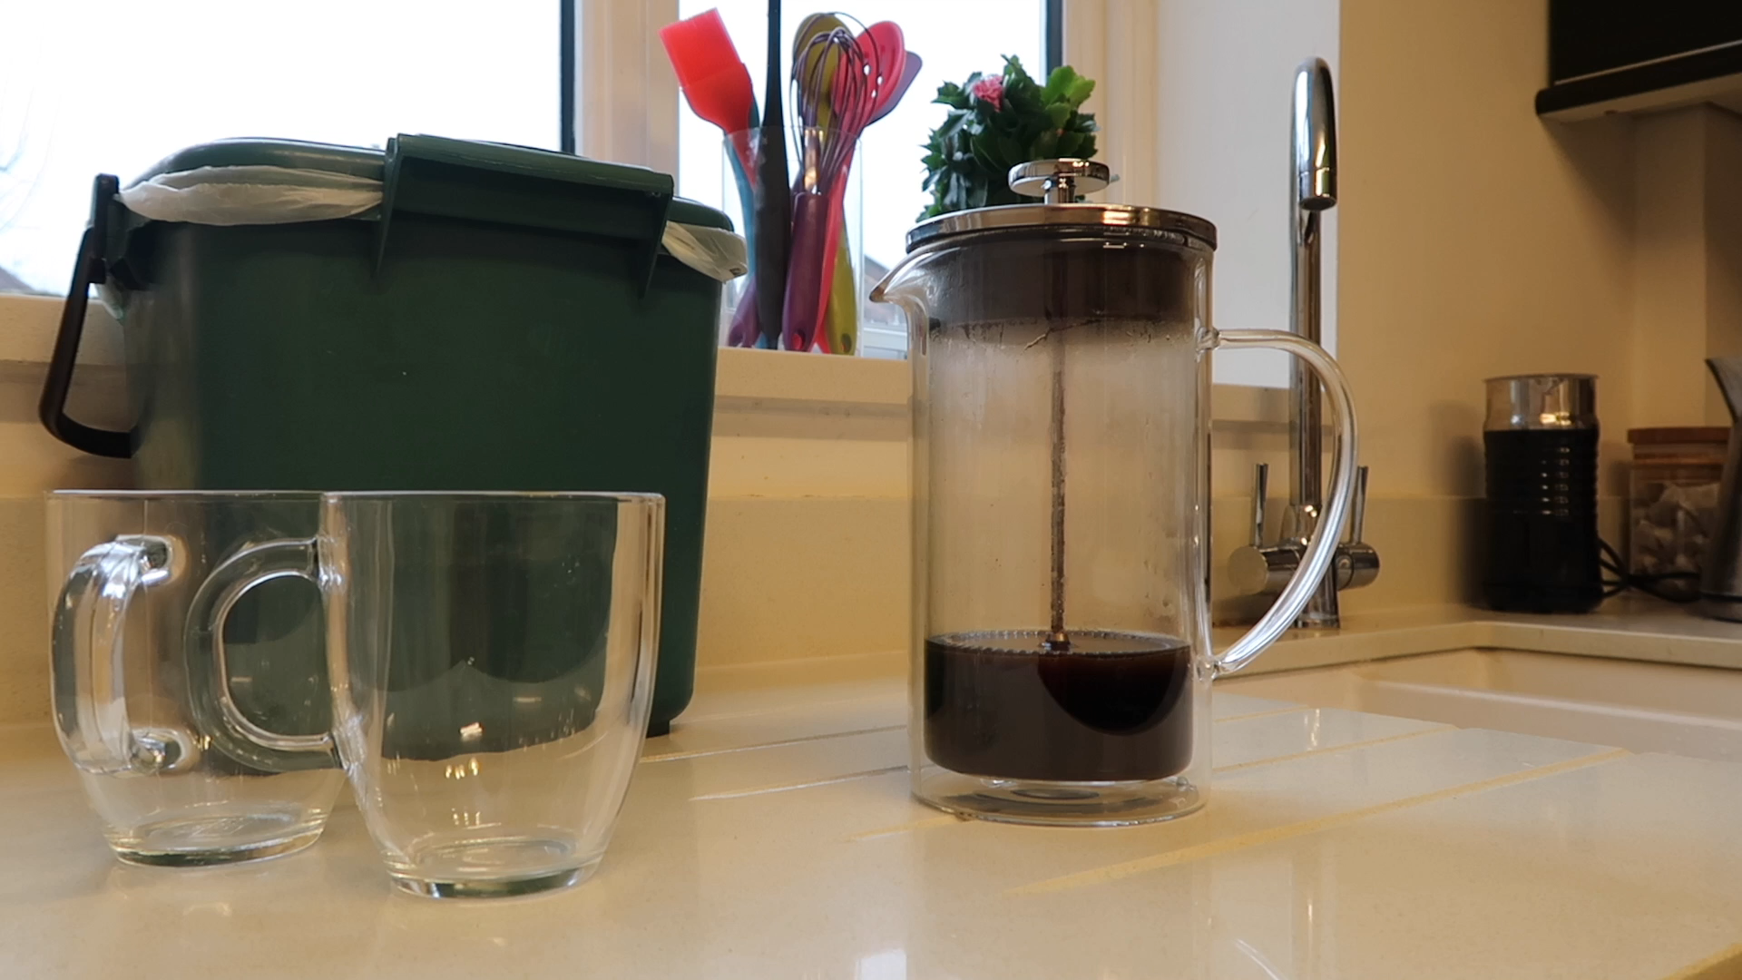
Home / scroll down
Cleans cafetieres easily
Video of scoof working

Slide 17
Mess free cleaning/ scroll down
Scoof® makes cleaning cafetieres easy
Wouldn’t cafetiere coffee be great without the mess?
Scoof® is a dedicated utensil designed to clean cafetieres. It has two blades that scoop and clean out the used coffee grounds in a simple twist
The grounds can be tapped in the food bin or used as compost
Pour off excess liquid
Lift out grounds
Insert Scoof® and twist
Tap into bin

Slide 18
Block free sinks & drains
The scoop with a twist
Home
Cafetiere coffee
Mess free cleaning
Recycle & compost
Block free sinks
FAQs
Shop
Scoof® cleans cafetieres easily

Slide 19
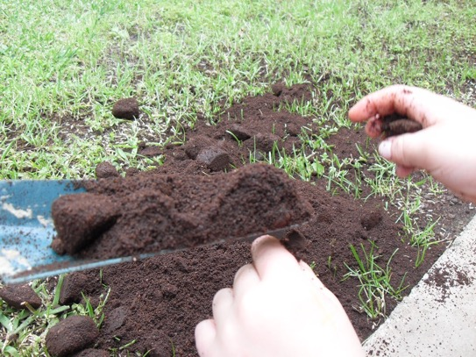
Recycle & compost / Scroll down
Why not use coffee grounds as compost?
Making fresh coffee washes the grounds and leaves a pH neutral fibrous grounds that can be used as a nitrogen rich compost.
Scoof® lifts out the waste grounds in an easy and convenient action – makes collecting coffee for the compost bin simple and mess free.
Image of coffee compost

Slide 20
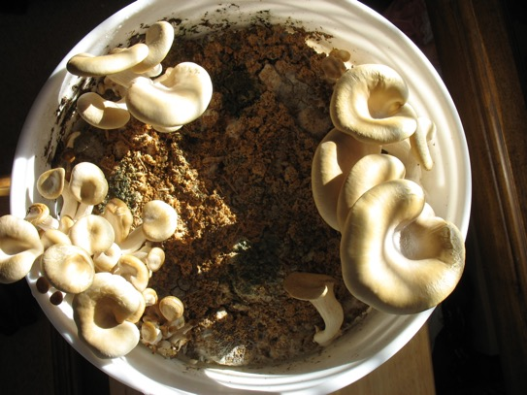
Recycle & compost / Scroll down
Try growing oyster mushrooms on coffee compost
Mushrooms can be grown on fresh coffee waste - it works so well as the compost has been pasteurized by the coffee brewing process.
Spent coffee grounds are still packed full of nutrients that oyster mushrooms can thrive on.
There are a number of online suppliers who can provide you with oyster mushroom spores to start you off.
Image mushrooms

Slide 21
Recycle & compost
The scoop with a twist
Home
Cafetiere coffee
Mess free cleaning
Recycle & compost
Block free sinks
FAQs
Shop
Scoof® cleans cafetieres easily

Slide 22
Block free sinks & drains /scroll down
Image sink blockages
Coffee grounds can cause blockages and are better collected as compost
Coffee grounds are gritty and when they combine with oils and fats thay can cause blockages.
Water companies recommend that solids are not put down the sink or toilet as these can accumulate into a solid mass in drains and sewers – large ones are called ‘fatbergs’ and can cost millions to remove.
Scoof® collects coffee grounds and helps prevent these issues.

Slide 23
FAQs
The scoop with a twist
Home
Cafetiere coffee
Mess free cleaning
Recycle & compost
Block free sinks
FAQs
Shop
Scoof® cleans cafetieres easily

Slide 24
FAQs / Scroll down
Is cafetiere the same as a French Press / Coffee Press / Plunger Pot?
Cafetiere is a common name for a type of coffee preparation method where ground coffee is infused in a tall pot and the grounds separated from the hot water using a circular mesh plunger. Cafetieres are called a range of different names around the world including; French Press, Coffee Plunger, Plunger Pot, Cafetiere a Piston, Coffee maker, Koffiekan, Kaffeebereiter, Caffettiera, Кофейник . . .

Slide 25
FAQs / Scroll down
How do I know that Scoof® will fit my cafetiere?
There are 3 sizes of cafetiere and currently one size of Scoof® (more to come soon!). Cafetiere sizes are generally measured in small espresso cup sizes. Scoof® is designed to fit standard 8 cup cafetieres (1 litre or 35.2 fl oz). Scoof® has a diameter of 8.4cm is designed to be slightly smaller than the plunger diameter to ensure a good fit (generally 8.5cm+). Scoof® also fits most 4 and 6 cup cafetieres which have a similar plunger diameter. Scoof® may be used in a 12 cup cafetiere, although it will be less efficient as the plunger diameter is generally 10cm. Scoof® will not fit smaller 3 cup cafetiere sizes (plunger diameter of 6cm+

Slide 26
FAQs / Scroll down
Do you make a larger Scoof® for when I want to brew a 12 cup cafetiere of coffee?
We don’t currently make a larger Scoof®. But the current standard size Scoof® will fit a 12 cup cafetiere and can be used a s a dedicated cleaning tool.

Slide 27
FAQs / Scroll down
Do you make a smaller Scoof® for when I want to brew a 3 cup cafetiere of coffee?
We don’t currently make a smaller Scoof® and a standard size scoof will not fit a 3-cup cafetiere. We plan to offer a smaller Scoof ® soon!

Slide 28
FAQs / Scroll down
Can I compost used coffee grounds?
Yes. Once you are finished with making coffee simply eject the puck of grounds and filter into your compost bin®

Slide 29
FAQs / Scroll down
Can I damage my Scoof ® when putting it into hot coffee?
Scoof® is designed to withstand temperatures of boiling water, hot coffee is generally at a lower temperature. Scoof® should not be used as a general cooking utensil as pan heats may exceed 100ºC.

Slide 30
FAQs / Scroll down
My Scoof® is becoming discoloured, what can I do to fix this?
Some people have solved this issue by simply putting the Scoof® through a dishwasher cycle.

Slide 31
FAQs / Scroll down
The waste coffee is slipping off the Scoof®, how do I fix this?
The Scoof® blades are designed to collect damp used coffee grounds after the cafetiere has been drained of excess coffee liquid.

Slide 32
FAQs / Scroll down
What is the Warranty on the Scoof®?
Scoof® is warranted against defects in materials and workmanship for a period of one year from date of purchase from an authorized retailer. We advise you to keep your receipt so that if you have a problem with your Scoof® before one year has passed, you can prove when you purchased it and that you purchased it from an authorized retailer that sells genuine Scoof® cafetiere cleaners.

Slide 33
FAQs / Scroll down
What material do you use for Scoof®?
It is a food grade thermoplastic polymer called ABS (acrylonitrile butadiene styrene).

Slide 34
FAQs / Scroll down
Does Scoof® contain BPA?
No. Scoof® is free from BPA (bisphenol-A).

Slide 35
FAQs / Scroll down
Can I recycle Scoof®?
Yes. At the end of its life Scoof® can be recycled.

Slide 36
FAQs / Scroll down
What grind should I use?
Use a coarse grind to get the best results from a cafetiere.

Slide 37
FAQs / Scroll down
Can I make a real espresso in a cafetiere?
A true espresso is made with 9 bars of pressure and a cafetiere does not create this amount of pressure. If you use this definition then no, the cafetieres do not not make espresso. But if you define espresso by the taste of the drink in the cup, certainly a cafetiere ac create a strong tasting coffee.

Slide 38
FAQs / Scroll down
How do I make a cappuccino?
A cappuccino is made up of equal parts espresso, hot milk, and foamed milk. The traditional way of foaming and heating milk is with steam. But those who have tried battery powered stirrers agree that they do a great job of foaming milk and are very easy to use and clean.

Slide 39
FAQs / Scroll down
How do I make a latte?
A latte is espresso mixed with hot milk. You can add hot milk to espresso style coffee or you can add cold milk and then heat the latte.

Slide 40
FAQs / Scroll down
Can I brew tea in a cafetiere?
Yes, simply add tea leaves to hot water in the cafetiere jar. Leave it to brew for a few minutes (according to taste). Then use the plunger to ‘strain’ the tea leave and stop the brewing process. Pour the tea as you would coffee!

Slide 41
Shop
The scoop with a twist
Home
Cafetiere coffee
Mess free cleaning
Recycle & compost
Block free sinks
FAQs
Shop
Scoof® Cleans cafetieres easily

Slide 42
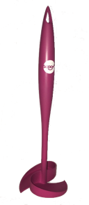
Shop / Scroll down
Need images that can be magnified/ rotated
Mulberry
Pumpkin
Ocean green
Navy Blue

Slide 43
Shop / Scroll down
Mulberry SKU XXXX
£9.95
Qty
1
Scoof® makes cleaning cafetieres easy and mess free. Enjoy the simplicity and quality of cafetiere coffee. Afterwards drain the cafetiere and use Scoof® as the easy and convenient way to clean up
Features:
Two angled blades that pick up the coffee grounds with a twist
A 8.7cm blade diameter that collects all of the waste grounds (fits standard 8 cup cafetieres and 4 and 6 cup versions)
A wall to keep the grounds on the blade (like a scoop)
A large comfortable , ergonomic handle to make the twisting motion easy
Collect 80% of grounds on first twist, 90% with second twist and 95% on third twist
Simply tap out grounds in the compost/ waste bin
Rinse under the tap or put in the dishwasher

Slide 44
Website content
Using http://www.aeropress.co.uk as a template
Need a sign up log in
Need a ‘uses cookies’ message

Slide 45
Proposed Scoof® colours - SELECTIONS
‘Burgundy’
‘Mulberry’
‘Burgundy’
‘Pumpkin’
‘Ocean Green’
‘Navy Blue’

